Slide 1

AI IN THE U.S. LABOR FORCE
GROUP 8: ABDULLAH “AB” IBRAHIM, AL WAGNER, EDILBERTO “DEL” VINAS, JAY HOWARTH, CRYSTAL WHITE

Slide 2
EXECUTIVE SUMMARY
Project Overview
Questions to answer:
What does the BLS employment data say about how technology jobs have changed in the past?
What does the BLS employment data say about how technology jobs are likely to change in the future?
What does the BLS employment data say about the change in technology roles relative to other occupations?
What does the BLS employment data say about the change in technology roles within specific industries?
What does the BLS employment data say about median wage for technology workers?
What is happening now with AI-related jobs? (potential, supplementary data analysis and/or reports)
How We Approached the Project
How We Approached the Data Sourcing, Manipulation & Analysis
What We Learned
Results & Conclusions
Remaining Questions for Future Exploration
Appendix

Slide 3

HOW WE APPROACHED THE PROJECT
Notes:
Breakdown of our approach

Slide 4
READY, FIRE, AIM
Project review
Discussion of data sources & decision on BLS
Project timeline & outline
Tutoring session & initial pull of BLS data
Deeper data review & pivots
Illustrative examples of story we could tell (initial presentation creation)
Selection of specific types of data
Coding, testing, GitHub load, rinse, wash, repeat
Documentation (ReadMe)
Tutoring session (2) + Kadoa Co-founder discussion
Final analysis & presentation refinement

Slide 5

HOW WE APPROACHED THE DATA SOURCING, MANIPULATION & ANALYSIS
Notes:
Breakdown of our approach

Slide 6
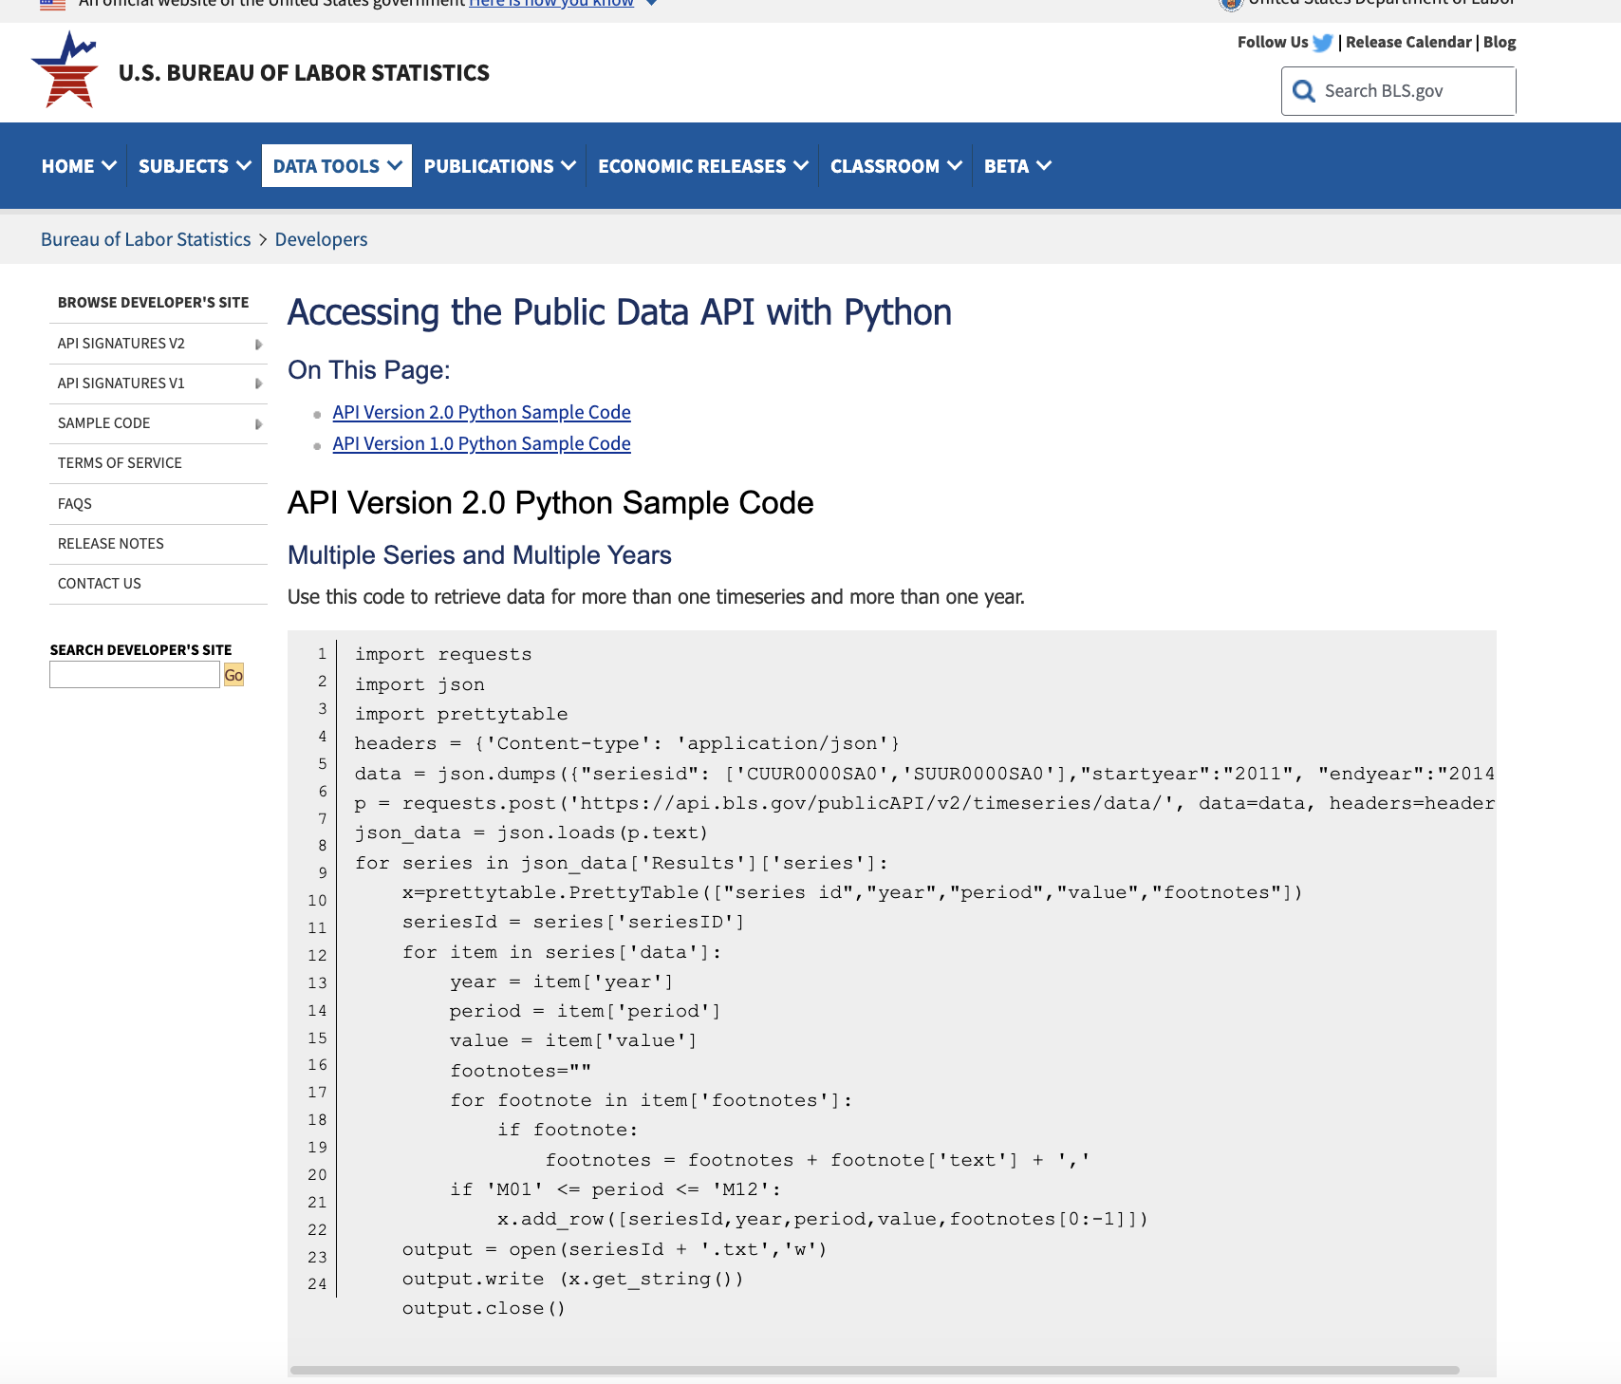
GETTING OUR HANDS ON SOME, BUT NOT TOO, MUCH DATA
The Approach
URLs for initial analysis: https://www.bls.gov/help/hlpforma.htm
API access: https://www.bls.gov/developers/api_python.htm
Breaking down code, data merges & manipulation, data visualization
Pivot: Computer science roles for multiple NAICS + Job data for AI-related roles
Supplementary information (BLS, White House report, tutoring sessions, Kadoa Co-founder discussion)
Kadoa (potential)

Slide 7

WHAT WE LEARNED
Notes:
Breakdown of our approach

Slide 8
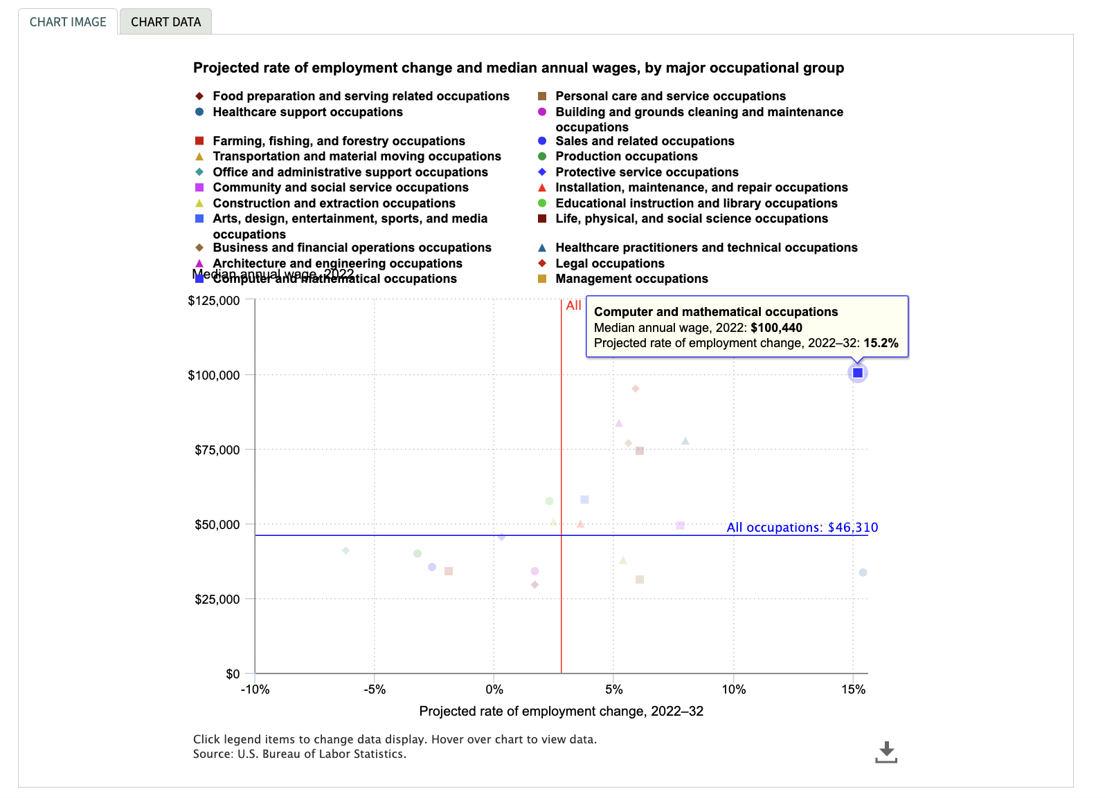
KEY FINDINGS FROM BLS DATA
White House AI Report Stat/ Quote
Employment’s about to get rocky, yo
Certain computer science jobs are at risk for automation
Be glad you’re in this bootcamp
Rise of the Machines is gonna be a rollercoaster, so now’s a really good time to get into AI
FPO
Source (linked)
Notes:
Computer and mathematical occupations (15%) & $100k median annual wage
Healthcare occupations (15%) & $30k median annual wage

Slide 9
2019-2022 TECH JOBS (ANNUAL)
White House AI Report Stat/ Quote
Data could be NAICS 15-1210, 15-1250, 15-2041, 15-2051
FPO
Link to suggested data elements
Source (linked)

Slide 10
2020-2021 TECH JOBS, MONTHLY (COVID SLICE)
White House AI Report Stat/ Quote
Data could be NAICS 15-1210, 15-1250, 15-2041, 15-2051
FPO
Source (linked)

Slide 11
2024-2029 TECH JOB PROJECTIONS (ANNUAL)
White House AI Report Stat/ Quote
Data could be NAICS 15-1210, 15-1250, 15-2041, 15-2051
FPO
Source (linked)

Slide 12
TOP 3 INDUSTRIES FOR TECH JOBS
Data could be top 3 industries employing computer science for years 2019-2022
White House AI Report Stat/ Quote
FPO
Source (linked)

Slide 13
WAGE GROWTH TECH JOBS (2014-2034)
Data could be NAICS 15-1210, 15-1250, 15-2041, 15-2051
White House AI Report Stat/ Quote
FPO
Source (linked)

Slide 14
UNEMPLOYMENT RATES TOP 3 GROWTH INDUSTRIES (2012-2022)
White House AI Report Stat/ Quote
Data could be tech jobs, healthcare support, healthcare practitioner, &/or social services

Slide 15
KADOA FINDINGS - ROLES
Potential appendix
Most often occurring job postings:
LinkedIn
Indeed
Less often occurring job postings:
LinkedIn
Indeed
Non-tech
Tech
FPO
LLM
Business analysts
Programmers
Prompt engineers
Data scientists

Slide 16
KADOA FINDINGS - SKILLS
Potential appendix
Most often occurring job skills posted:
LinkedIn
Indeed
Less often occurring job skills posted :
LinkedIn
Indeed
Non-tech
Tech
FPO
Python
Prompt building
VS Code
Information architecture
Building Transformers

Slide 17
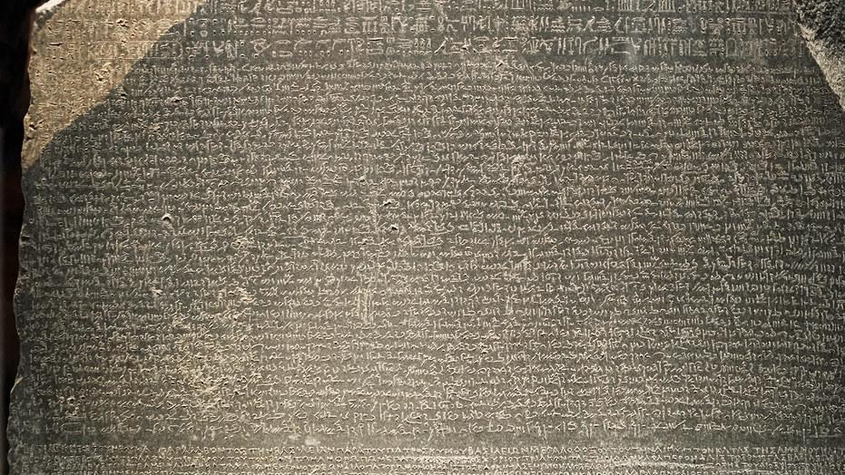
WHAT WE LEARNED
This Photo by Unknown Author is licensed under CC BY-SA-NC
Notes:
Breakdown of our approach

Slide 18
RESULTS & CONCLUSIONS
Crystal is great to have on a team. ☺
This pilot is a pain in the ass but so worth it
Get your resume & portfolio ready
Now is the best time to be in AI

Slide 19

FUTURE RESEARCH
Notes:
Breakdown of our approach

Slide 20
AREAS TO EXPLORE WITH FUTURE RESEARCH
Analysis by geography (who wants to live somewhere warmer?)
Kadeo accessing BLS stats
AI-related occupations as its own, new role (White House quote)
Which roles are likely to be augmented by AI?
How many US jobs does that change and in which industries?
How can that workforce skill up in preparation for changes to come?
Which roles are likely to be automated by AI?
How many US jobs does that eliminate and in which industries?
How can that workforce reskill in preparation for changes to come?
What new roles and industries are likely to be created by AI?
What new industries may be created?
What new roles in existing industries may be created?
How will companies be able to access or build the skills they need related to AI roles?

Slide 21
APPENDIX
SUPPLEMENTARY READING AND RESOURCES

Slide 22
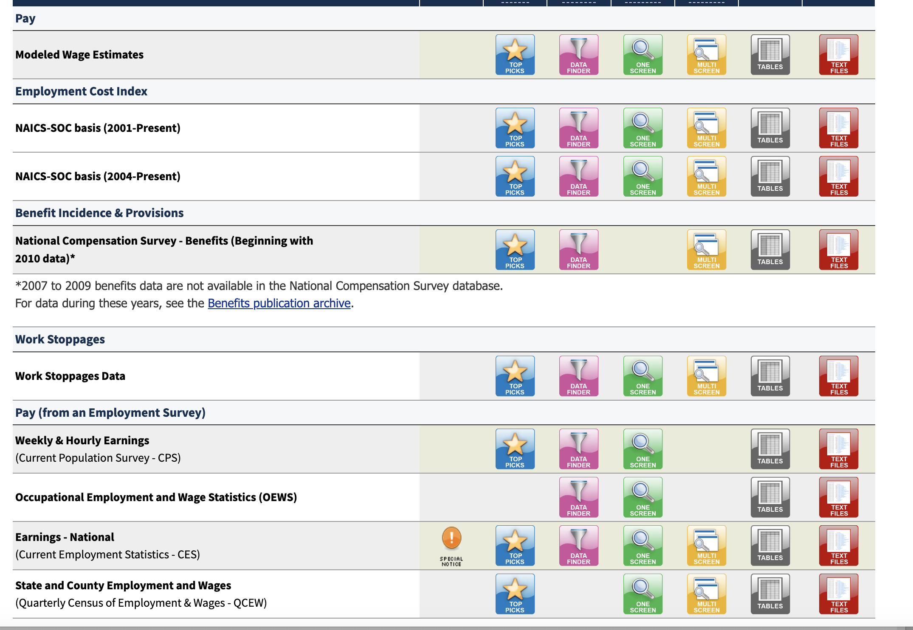
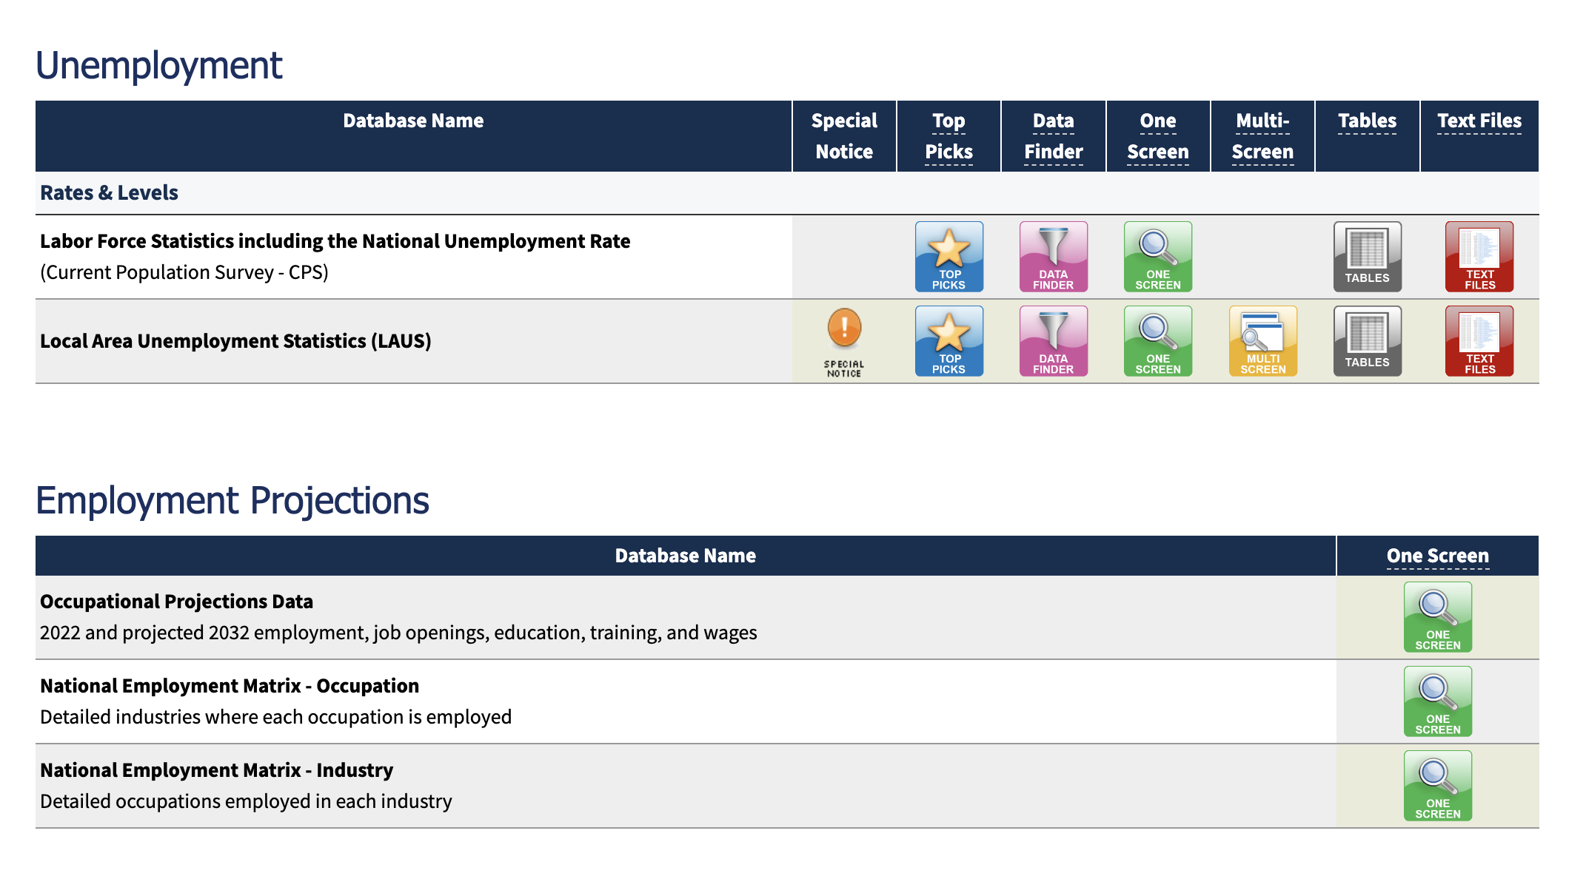
BLS DATA EXAMPLES
FPO

